Slide 1
Mind Mapping
Webs
Concept maps
Think links
1

Slide 2
Mapping is an effective tool for organizing and planning
Maps lead to a better understanding of the conceptual organization of the discipline and the subject
2

Slide 3
Mapping
Mapping is a relatively new knowledge representation tool being used by educators, researchers and others interested in the process of learning.
It grew out of a need to represent changes in student cognitive structures in science education research begun in the 1960s at Cornell University.
3

Slide 4
Mapping
Mind maps are graphical representations that can provide insight into relationships among various concepts.
The power behind mind maps derives from the belief of many researchers and psychologists that concepts are ultimately understood through their relationships with other concepts.
4

Slide 5
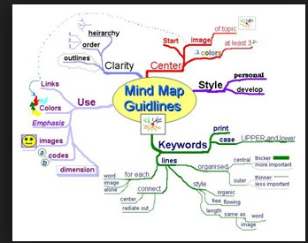

Slide 6
Mapping
Many of us have learned to outline information in our studies.
I. First item
II. Second item
A. sub item
B. sub item
1. sub sub item
2. sub sub item
III. Third item
6

Slide 7
GRAPHIC (AND OTHER) ORGANIZERS
Several kinds of organizers help us arrange and practice information for memory. One of these is concept mapping, a highly visual system which uses geometric shapes to graphically indicate how ideas are related. Mapping enables the student to “see” the relationships and better understand the concept presented.
3 MEMORY PROCESSES
Encoding
Retrieval
(Getting information in)
(Taking info out)
Storage
Storage
(Retaining Information)
Visual Sense
Kinesthetic Sense
Auditory Sense
“Working” Memory
Long term Memory

Slide 8
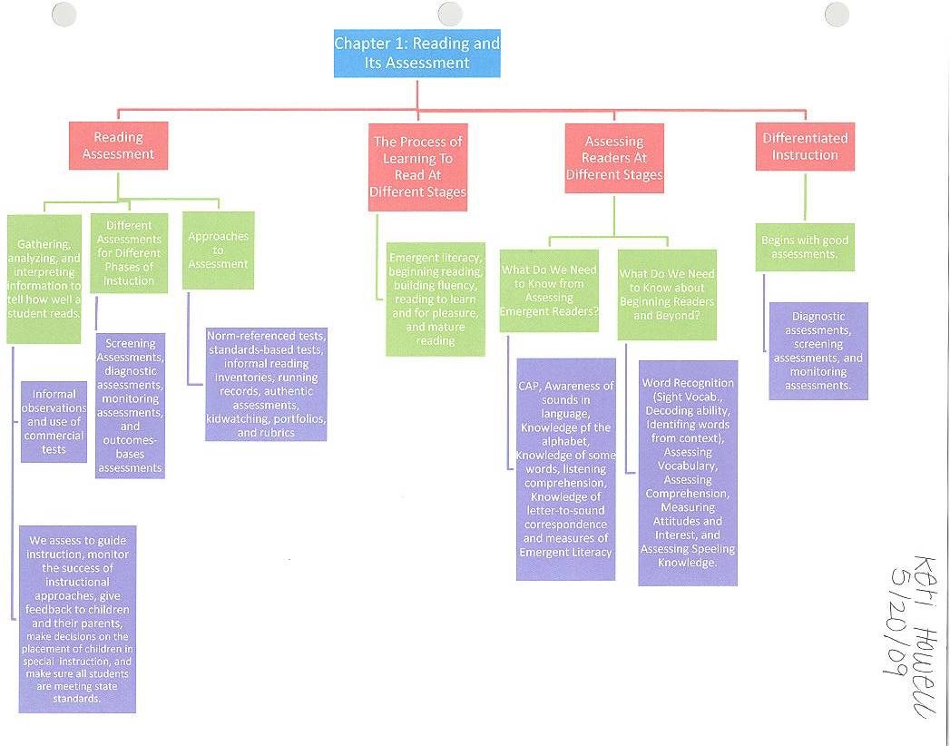
Notes:
This is another example of a map used to organize information in a chapter from a textbook.

Slide 9
Mapping
How do I map?
Think in terms of key words or symbols that represent ideas and words
You will need:
a pencil (you'll be erasing!) and a blank (non-lined) big piece of paper
a whiteboard and markers
"post-it" notes
9

Slide 10
Mapping
Write down the most important word or short phrase or symbol for the topic in the center.
Think about it; circle it.
10
Notes:
If you were completing a map from your science textbook, it might look something like this.

Slide 11
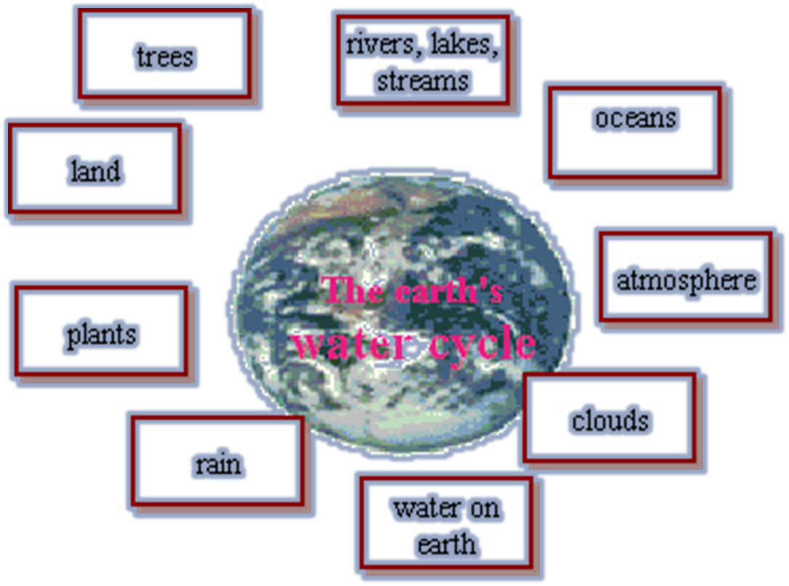
Edit this first phase Think about the relation of outside items to the center item Erase, edit, and/or shorten words to key ideas Relocate important items closer to each other for better organization If possible, use color to organize information Link concepts with words to clarify their relationships
11

Slide 12
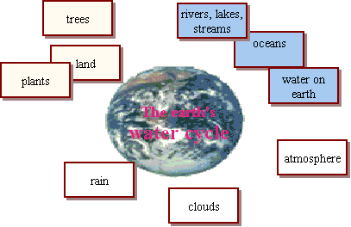
Continue working outward Freely and quickly add other key words and ideas (you can always erase) Synthesize: combine concepts to expand your map or; break boundaries Develop in directions the topic takes you--not limited by how you are doing the map As you expand your map, tend to become more specific or detailed
12

Slide 13
Set the map aside Later, continue development and revision Stop and think about relationships
you are developing Expand the map over time
This map is your personal learning document It combines what you knew with what you are learning and what you may need to complete your "picture"
13

Slide 14
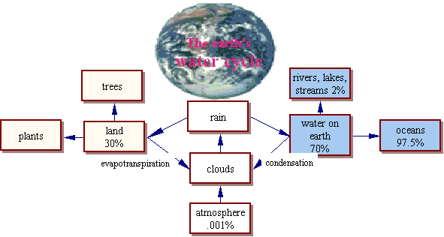
Flash exercise contributed by Aaron Shapiro & Dustin Schiltz; Luoise Lystig Fritchie, Interactive Media (DHA 5341) School of Design, University of Minnesota
14

Slide 15
Tony Buzan's video from "Youtube" What is, and how to create a mindmap Mind mapping was developed by Tony Buzan:
The Mind Map Book: How to Use Radiant Thinking to Maximize Your Brain's Untapped Potential",
Penguin Books, New York.
15

Slide 16
IHMC CmapTools version 4.09 (free!)
The CmapTools client is a free mapping toolkit.
Free Mapping Toolkits
mindmeister.com
The Brain
http://www.thebrain.com/?gclid=CLSrvvTH_58CFQ0fswodXC7Clg
http://www.readwritethink.org/files/resources/interactives/graphicmap/
16

Slide 17
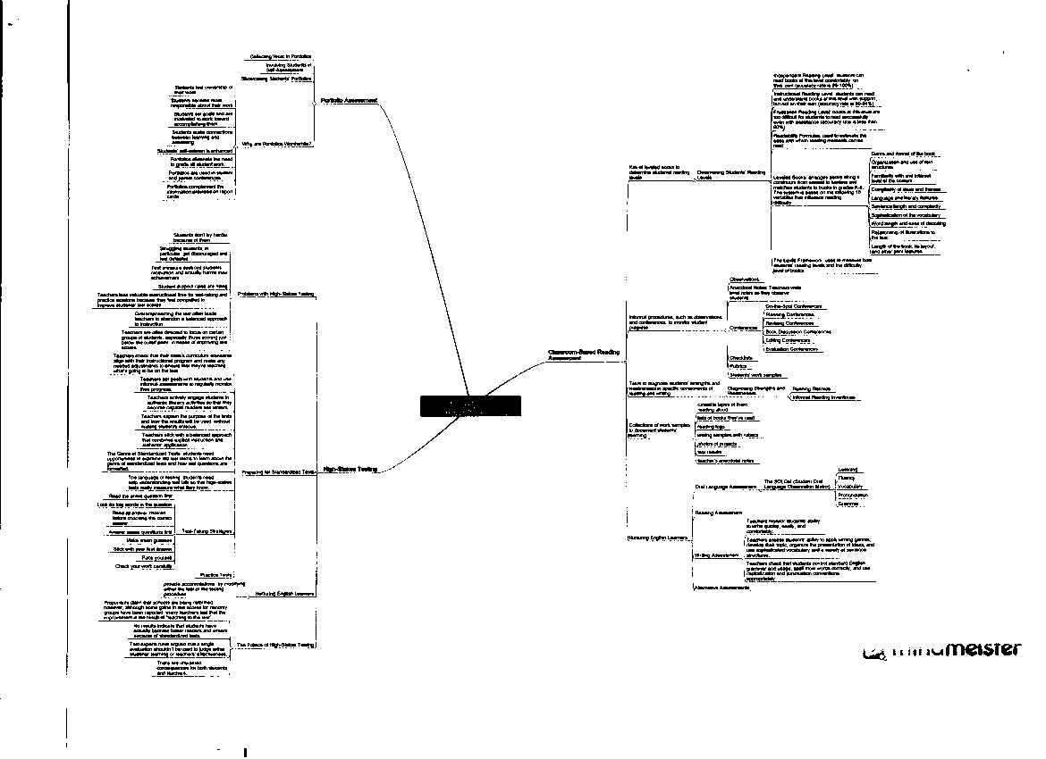
17
Mindmeister.com
Notes:
This is an example of a map completed on a computer. The link is mindmeister.com

Slide 18
Tony Buzan’s Software
Notes:
This is an example of a map completed on Tony Buzan’s software.

Slide 19
http://www.readwritethink.org/files/resources/interactives/graphicmap/
Link to creating a computer map
19

Slide 20
Mind Mapping
Mind Maps are also useful for:
Summarizing information.
Consolidating information from different research sources.
Thinking through complex problems.
Presenting information in a format that shows the overall structure of your subject
20

Slide 21
Steps Involved
To make notes on a subject using a Mind Map, draw it in the following way:
Write the title of the subject you're exploring in the center of the page, and draw a circle around it.
Learning Styles
21

Slide 22
STEPS
As you come across major subdivisions or subheadings of the topic (or important facts that relate to the subject) draw lines out from this circle. Label these lines with these subdivisions or subheadings.
VARK
Visual, aural,
Read-write
Kinesthetic
Learning Styles
22

Slide 23
STEPS
As you "burrow" into the subject and uncover another level of information (further subheadings, or individual facts) belonging to the subheadings above, draw these as lines linked to the subheading lines.
VARK
Multi-modal
Fleming
Visual, Aural,
Read-write,
Kinesthetic
Multiple
Intelligences
Learning Styles
Gardner
Verbal-Linguistic, Logical-Mathematical
Bodily-Kinesthetic, Visual-Spatial, Interpersonal
Intrapersonal, Musical, Naturalistic
23

Slide 24
STEPS
.
Improving your Mind Maps
Once you understand how to make notes in the Mind Map format, you can develop your own conventions to take them further. The following suggestions may help to increase their effectiveness:
.
24

Slide 25
STEPS
Use single words or simple phrases for information: Most words in normal writing are padding: They convey facts in the correct context, and in a format that is pleasant to read. In your own Mind Maps, single strong words and meaningful phrases can convey the same meaning more potently. Excess words just clutter the Mind Map.
.
25

Slide 26
STEPS
. Print words: Joined up or indistinct writing can be more difficult to read. Use color to separate different ideas: This will help you to separate ideas where necessary. It also makes your Mind Map easier to remember. Color also helps to show the organization of the subject.
.
26

Slide 27
STEPS
Use symbols and images: Where a symbol or picture means something to you, use it. Pictures can help you to remember information more effectively than words.
.
27

Slide 28
STEPS
. Using cross-linkages: Information in one part of the Mind Map may relate to another part. Here you can draw in lines to show the cross-linkages. This helps you to see how one part of the subject connects with another.
28

Slide 29
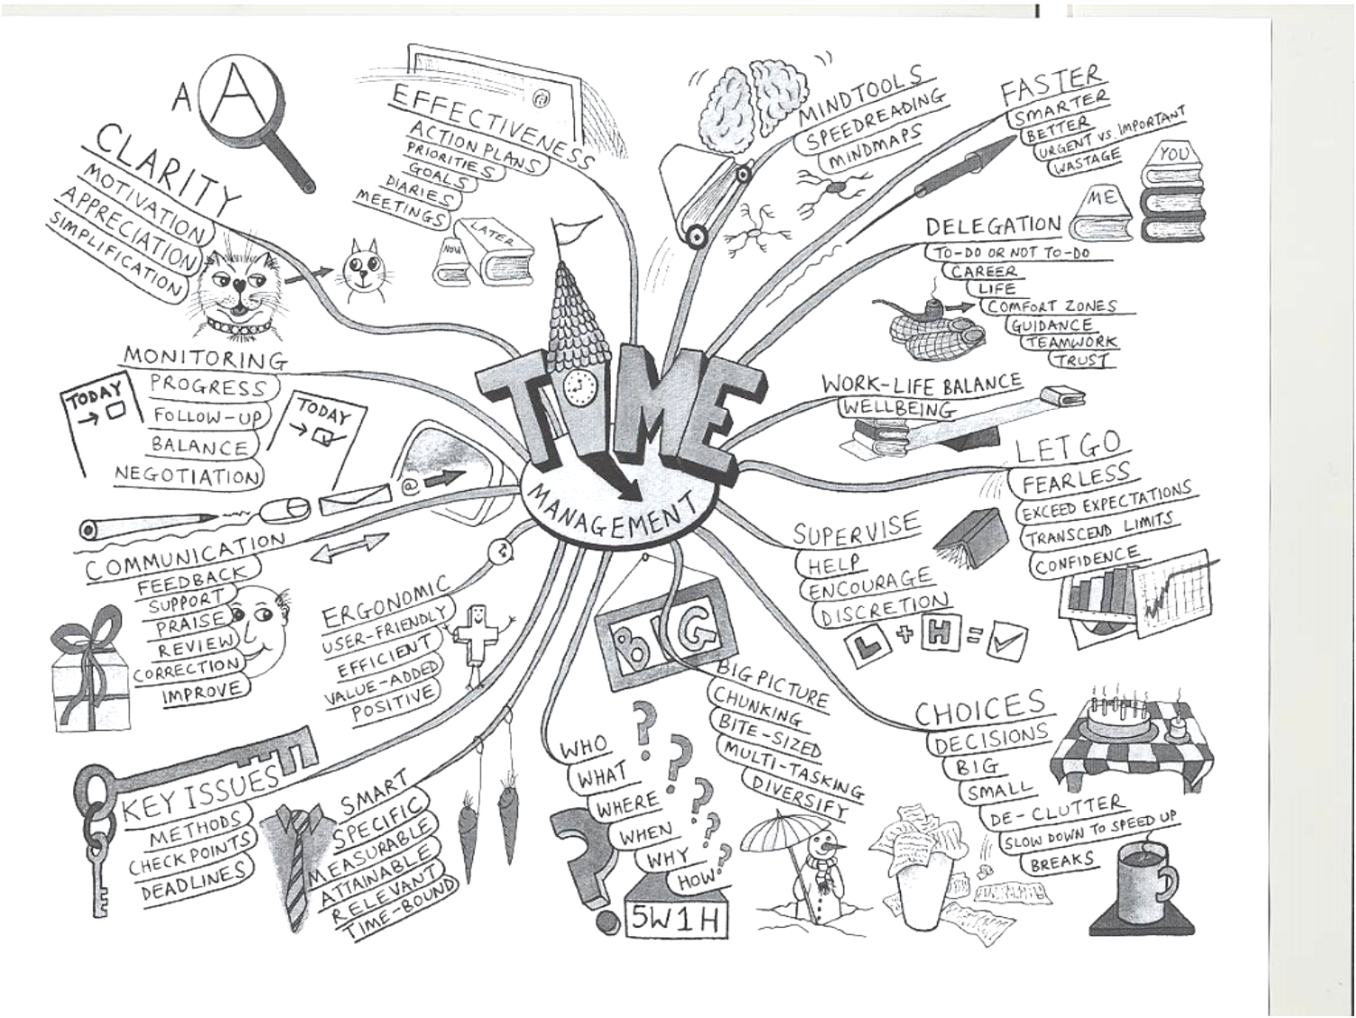
29
Notes:
This is an example of a mind map on time management.

Slide 30
Mind Mapping
Mind Mapping is an extremely effective method of taking notes.
Mind Maps show not only facts, but also the overall structure of a subject and the relative importance of individual parts of it.
They help you to associate ideas and make connections that you might not otherwise make
30

Slide 31
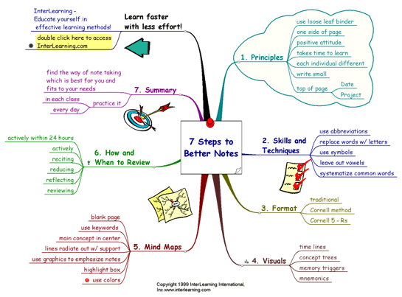

Slide 32
That’s All!

